Slide 1
Inclusive Placement Opportunities for Preschoolers: A Systems Approach to Preschool Inclusive Practices
A project of the Virginia Department of Education and the Technical Assistance Centers of Virginia
Notes:
Note to presenter: This module can be changed to reflect the needs of your audience; save the presentation to a location on your computer and make necessary changes.
This module contains activities to promote participant involvement aimed at improving retention of information presented. To learn more about participant-centered training strategies please refer to: Pike, R. (2002). Creative teaching techniques handbook: Tips, tactics, and how-tos for delivering effective training (3rd ed.). Amherst, MA: HRD Press. Or visit the Web site at www.bobpikegroup.com.

Slide 2
Module 5:
Fostering Self-Regulation in Young Children

Slide 3
Learning Objectives
Participants will learn how children develop self-regulation skills
Participants will understand the importance of supporting children’s development of self-regulation skills
Participants will learn how to plan instruction to teach self-regulation skills
Notes:
Presenter: Review objectives.

Slide 4
What pushes your hot button?
Traffic
Someone cutting the line
Social media drama
Teaming challenges
Unpredictable changes to your day
Notes:
In this context, a “hot button” is a situation that causes stress and dysregulation.
Activity: Read the question and ask participants to consider if any of the examples provided on the slide would be a trigger or hot button for them.
Ask participants to take 5 minutes to discuss the following in small groups or with a shoulder partner.
How often to these triggers arise?
How do they affect your ability to interact with others?
How do you manage your feelings of stress in the moment?
Now brainstorm a list of behaviors that children demonstrate that are triggers or really push your buttons.
It’s important for us as adults (e.g., parents, teachers, coaches, administrators, etc.) to understand how we respond to stressful situations when interacting with children so we can be ready when children need our support.

Slide 5
What is self-regulation?
A complex process that allows individuals to consciously control their thoughts, emotions, and actions.
Notes:
Let’s begin by defining self-regulation.
Read information on slide. Simply stated, self-regulation is one’s ability to “stop, think, then act” (McClelland & Tominey, 2015, p.4).
Self-regulation is not an isolated skill. Children must also tap into other parts of their development (e.g., cognitive, communication, adaptive, motor) to consciously engage in the self-regulation process.
Children must translate what they experience into information they can use to regulate thoughts, emotions, and behaviors.
Self-regulation skills help children manage all three components of their executive function (i.e., cognitive flexibility, working memory, and inhibitory control).
Research shows us that children who are able to regulate, or manage their emotions and behaviors, do better in school and have an easier time getting along with peers. In fact, kindergarten teachers say self-regulation skills are the most important characteristics for school success.
Additional resource: Center on the Developing Child at Harvard University https://developingchild.harvard.edu/science/key-concepts/executive-function/

Slide 6
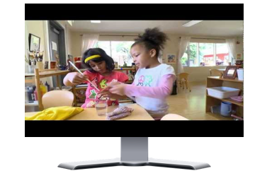
Executive Functioning
Retrieved from https://developingchild.harvard.edu/science/key-concepts/executive-function/
Notes:
Video length: 5 minutes
Source: https://developingchild.harvard.edu/science/key-concepts/executive-function/
This is a short In Brief video demonstrating how children use their executive function skills and provides scientific insight into how those skills develop and grow, as well as what can disrupt their development.

Slide 7
The Importance of Self-Regulation Skills
Self-regulation allows us to integrate all three aspects of executive function into behavior.
Notes:
Ask for additional takeaways from the video.
The image of an air traffic controller represents the job that self-regulation skills do for each of us. They integrate the three aspects of executive function and are expressed as a behavior.
Why is it important for young children to develop and use these skills? Recap bullets and tie back to the video.
Children who are able to tap into their self-regulation skills can do things like handle strong emotions, tolerate frustration, control their impulses, follow rules and expectations, pay attention, and delay gratification.
When children can regulate themselves, they are able to use different approaches to learning more effectively (i.e., demonstrate curiosity, apply prior knowledge to new learning, ask for help, look for alternative solutions).
Handout to extend the discussion related to brain science and impact on the development of self-regulation skills https://fpg.unc.edu/sites/fpg.unc.edu/files/resources/reports-and-policy-briefs/PromotingSelf-RegulationIntheFirstFiveYears.pdf

Slide 8
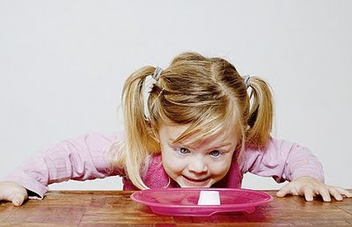
Factors That Influence Self-Regulation Skills
Child’s developmental stage
Environmental circumstances
Individual differences
Notes:
Handouts:
Co-regulation: An evidence-based approach to building self-regulation in early childhood. Murray, Gallagher, Rosanbalm, & Hamoudi, (2015).
Self-Regulation Assessment Rubric. Kristie Pretti-Frontczak (2018), https://prekteachandplay.com/SR-rubric
Ask participants to locate their handouts. Before using the handouts to look at the characteristics of self-regulation across the developmental stages of young children, we must first consider that when children demonstrate various self-regulation skills is highly dependent upon several factors.
The developmental progression for when children demonstrate various self-regulation skills will look different depending on the developmental stage of the child (e.g. infancy, toddlerhood, preschooler, early elementary).
Environmental circumstances or context surrounding a child affects development of self-regulation and the ability to engage in the self-regulation process (i.e., a child’s feelings about what is happening at home or school).
Individual differences such as how a child communicates (e.g., words, pictures, gestures, AT), the extent to which s/he is mobile, sensory needs, etc. will impact how the child engages in the self-regulation process.
Dr. Kristie Pretti-Frontczak has developed The Self-Assessment Rubric which looks at each of the sub-components of the self-regulation process across a progression beginning with foundational and ending with generative. Each level of proficiency correlates with the developmental stages (i.e., infancy=foundational) a child moves through as she or he ages and grows.

Slide 9
Characteristics of Self-Regulation
Notes:
Ask: What does self-regulation look like for infants, toddlers, and preschoolers? Can you think of common situations when children struggle to self-regulate?

Slide 10
Co-Regulation
Supportive, nurturing, safe, and responsive relationships with caregivers.
Notes:
The self-regulation process begins as an external process. Beginning at birth, Infants are dependent on others to help them self-regulate. Their job is to let caregivers know what they need by providing cues (e.g., crying and cooing).
As children grow and begin to engage differently, self-regulation begins to switch from an external process to an internal process. In order for this to happen, children need nurturing relationships with caregivers and safe opportunities to practice what they are learning.
Additional factors that play a role in children’s ability to make the shift:
The attachment relationship between child and adults at home and school/program (e.g., secure, trusting, and responsive)
Child’s exposure to adults and peers who model positive self-regulation skills
Caregiving styles of key adults (e.g., use of an authoritative teaching style)
Child’s maturation and brain development (i.e., growth of prefrontal cortex in early childhood)
Opportunities to practice or engage in self-regulation process (McClelland & Tominey, 2015, p.16).

Slide 11
Co-Regulation Coaching
Notes:
Use the handout provided to discuss how caregivers provide co-regulation across the developmental stages.
Handout: Co-regulation: An evidence-based approach to building self-regulation in early childhood. Murray, Gallagher, Rosanbalm, & Hamoudi, (2015).
Review handout with participants and discuss ways adults can support children by providing co-regulation.
Coaching children is consistent with DEC Recommended Practice
INT5. “Participants promote the children’s problem-solving behavior by observing, interpreting, and scaffolding in response to the child’s growing level of autonomy and self-regulation” (Division for Early Childhood, 2014, p.13).
Also refer to Performance Checklist for Child Social-Emotional Competence Checklist, (ECTA, 2018)

Slide 12
Children with Disabilities
Notes:
In a previous slide, it was mentioned that individual differences can impact when and how a child engages in the self-regulation process. Let’s unpack what this means for a child with a disability.
Ask: How could having a disability make engaging in the self-regulation process more challenging? Remember, to engage in the self-regulation process, it requires tapping into other parts of our development (e.g., cognitive, communication, adaptive, motor). Discuss with your shoulder partner (5 mins.) Ask for volunteers to share what they discussed.
Performance Checklist for Adult-Child Interaction Checklist, (ECTA, 2018)

Slide 13
The Role of Social-Emotional Development
“One’s emerging ability to effectively label, express, and regulate emotions, and to interact meaningfully with others by engaging in activities such as sharing, taking turns, delaying gratification, and smoothly making transitions between tasks” (Edward, 2017, p.4).
Notes:
This definition for social-emotional development is taken from Nicole Edward’s book, Early Emotional Development: Your guide to promoting children’s positive behavior.
Research tells us that there is a connection between our emotions and our ability to engage in the self-regulation process (MeClelland & Tominey, 2015 p. 8).
“The ability to identify and describe feelings and emotions is at the foundation of emotional regulation” (Grisham-Brown, Hemmeter, et al, 2017, p. 216). This requires communication skills to express how you are feeling, cognitive ability to interpret those feelings, impulse control to act in the moment, the ability to calm oneself.
Citation for source: Nicole Edward. (2017), Early social emotional development: Your guide to promoting children’s positive behavior. City, ST: Publisher.

Slide 14
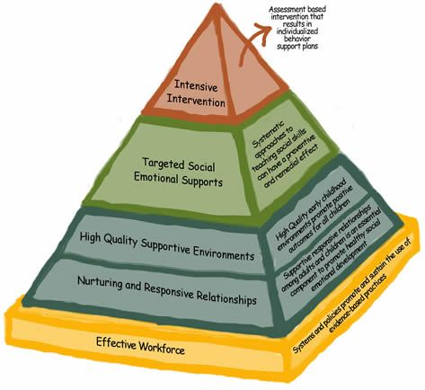
The Pyramid Model
Notes:
The Pyramid Model is an example of a three-tiered framework to promote social emotional development and prevent challenging behavior.
The universal tier promotes practices that foster social emotional well being for all through nurturing relationships between all and creating supportive environments.
The targeted tier focuses on providing children at risk for social emotional delays and challenging behavior with explicit instruction in social skills and emotional regulation.
The Intensive tier focuses on individualized interventions for a small number of children who are not responding to universal or targeted supports.
You will notice that practices that foster nurturing and supportive relationships are foundational in this model.

Slide 15
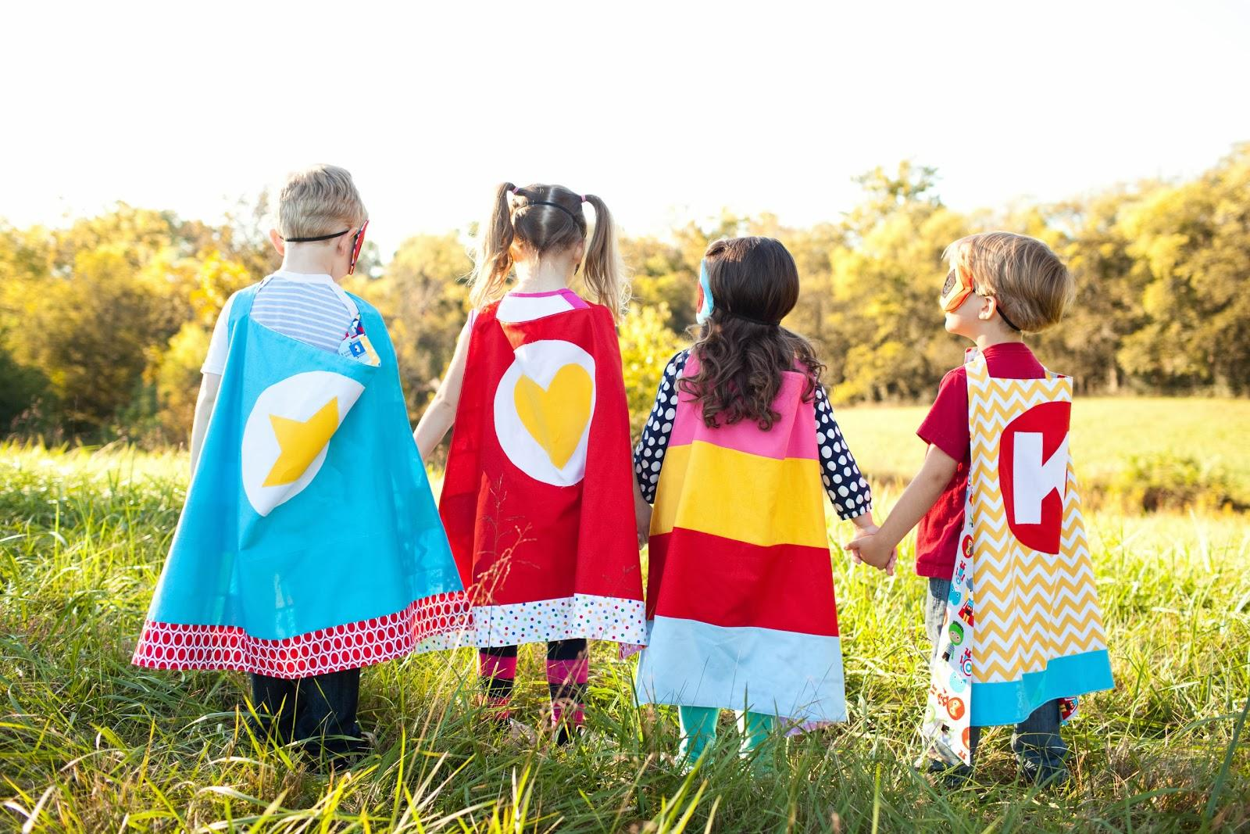
Nurturing and Responsive Relationships
“Children develop best when they have secure, consistent relationships with responsive adults and opportunities for positive relationships with peers” (Copple & Bredekamp, 2009, p.13).
Notes:
Fostering nurturing and supportive relationships with children and families is one of the principles of child development which supports the use of developmentally appropriate practice. The shift of self-regulation from an internal to an external process relies on the foundation provided by secure and supportive relationships between children and their caregivers.
Developing nurturing relationships extends to families as well. When teachers intentionally engage families, it plays a critical role in the social-emotional development of young children (Grisham-Brown & Hemmeter, 2017, p.207).
It teaches children about different expectations in different settings
It provides children with more examples of social behavior when adults act as a models
It changes the way important others respond to the child’s behavior when families see teachers model appropriate strategies

Slide 16
Practices to Create A Caring Community
Adults model social behaviors with others
Teachers assist another adult through teaming
Classroom jobs emphasize cooperation
Materials are available that encourage cooperation
Notes:
The context for nurturing and responsive relationships is also foundational to creating a caring community. Teachers should be intentional about helping children develop the prosocial behaviors that support the learning community (Grisham-Brown, Hemmeter, et al., 2017, p. 208-209).
Children are always watching. As we discussed on the previous slide, when children see their teacher modeling social behaviors with others, that signals how they should behave (ex., using manners like please, thank you, you’re welcome, or excuse me).
In front of the children, demonstrate teamwork (i.e., one prepare for meal while the other person reads a story)
Class jobs teach helpfulness and cooperation
Puppets, wagons, floor puzzles, parachute, musical instruments encourage children to invite their peers into their play.
Handout: Refer to Fostering self-regulation skills in the classroom
Draw participants attention to suggestions at the bottom of the page under Building a classroom community that supports self-regulation.

Slide 17
High Quality Supportive Environments
Provide positive feedback
Follow a predictable schedule and routine
Teach rules and expectations
Notes:
The second set of practices that are part of the universal tier involve the design and implementation of environments that support social-emotional development (Grisham-Brown & Hemmeter, 2017, p.210-11).
High quality supportive environments are the foundation for children to engage in the self-regulation process.
In the slides to follow, we will look at each feature individually.

Slide 18
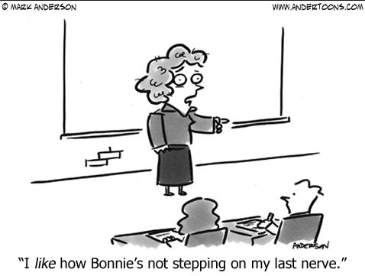
Give Positive Feedback at a Ratio of 5:1
For every 1 negative, you need to give 5 positives
Examine classroom expectations and practices
It all starts with strong relationships!
Notes:
The deposits and withdrawals that we make have a cumulative effect on our relationships with others. This is no different with young children.
If you find yourself out of ratio, reframe the situation and stay solution focused
Consider whether or not your expectations are age and developmentally appropriate for young children
Consistent with DEC Recommended Practice INS7. Practitioners use explicit feedback and consequences to increase child engagement, play and skills (DEC, 2014).
Handout: Starters for giving positive feedback http://challengingbehavior.cbcs.usf.edu/docs/ToolsBuildingRelationships_starters-for-giving-positive-feedback.pdf
Ask: How do you typically give children feedback when they have a breakdown in self-regulation?

Slide 19
The Pyramid Model (Blue Tier 1)
Retrieved from https://www.youtube.com/watch?v=RQLvVdbaJWw
Notes:
Retrieved from https://www.youtube.com/watch?v=RQLvVdbaJWw

Slide 20
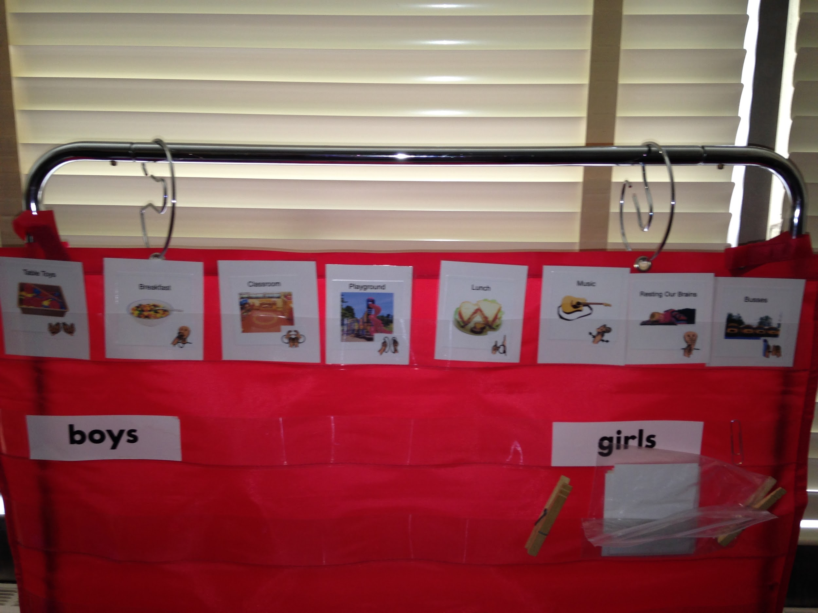
Follow a Predictable Schedule
“The schedule and how it is implemented is one of the single most important factors in preventing challenging behaviors” (Grisham-Brown, Hemmeter, Pretti-Frontczak, 2017).
Notes:
Following a predictable schedule meets children’s basic need for predictability and control. It also let’s children know how to behave.
Schedules work best when posted at eye level with words and photographs or images of the routines and activities of the day.
Ways that predictable schedules support social emotional development:
They support competence and confidence
They provide predictability
They help develop a sense of security and control
They provide opportunities for learning and development

Slide 21
Avoid Scheduling Pitfalls
Making changes on a whim
Not discussing changes with children
Inconsistent routines
Too many transitions
Too much unengaged time
Notes:
Disruptions in the schedule can be problematic and lead to self-regulation challenges for some children. It’s important to tell children about changes in the daily routine in ways that they can understand (i.e., visuals placed next to an activity, discussed during morning meeting, or a symbol placed on the picture schedule).
Ask: What are some ways you let children know if there is a change in the schedule?

Slide 22
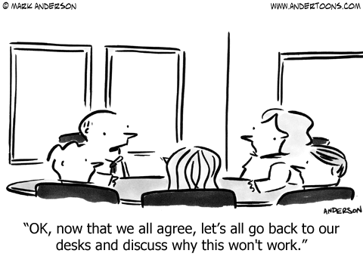
Activity: Group Problem Solving
Notes:
Activity (15 min.): Schedules and Routines: Group Problem Solving
From Early Childhood Learning and Knowledge Center; download and print facilitators guide at https://eclkc.ohs.acf.hhs.gov/sites/default/files/pdf/no-search/iss/managing-the-classroom/schedulesandroutines-la-opt-group.pdf
Write each scenario at the top of chart paper or large index cards. Divide participants into smaller groups. Ask them to brainstorm possible solutions. Depending on the amount of time, participants can rotate between scenarios. Take turns reporting out.

Slide 23
Classroom Rules and Expectations
Begin by teaching behavior expectations
Observe routines to see when children need more information
Establish rules for routines and activities
Use a behavior matrix to guide your teaching
Notes:
Establishing expectations and rules is a universal support used to encourage appropriate social-emotional behaviors and prevent challenging behavior (Grisham-Brown, Hemmeter, et al, 2017, p.212).

Slide 24
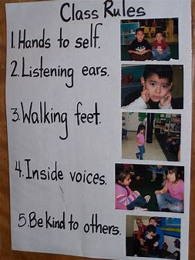
Establishing Classroom Rules
3-5 rules
Observable language that is positively stated
Age appropriate
Visual and posted at eye level
Notes:
When developing behavior expectations or rules for the group, ask yourself, what do I want to see versus what don’t I want to see?
Consider involving the children in developing the “rules” for each expectation. Offer a simple rational (i.e., safety concerns), and then ask them to brainstorm ideas.

Slide 25
Behavior Matrix Across Routines, Slide 1
 | Arrival | Circle | Center Play | Snack
Be respectful | Greet peers and adults | Accept who sits by you Invite someone to sit next to you | Take turns | Accept who sits by you Talk to friends about the day
Be safe | Keep hands to yourself Walk in classroom | Keep hands/feet to yourself Sit on your bottom | Keep hands/feed to yourself Use materials appropriately | Keep hands/feet to yourself Put an appropriate amount of food in mouth
Notes:
Presenter: Ask if anyone has seen or used a behavior matrix before. Explain that to create a matrix, list the expectation down the side and the setting, routine or activity across the top.
The matrix on the slide is based on the routines of the day. Notice that observable language is used to describe the behaviors we expect to see from everyone.

Slide 26
Behavior Matrix Across Routines, Slide 2
 | Arrival | Circle | Center Play | Snack
Be a team player | Get off bus Hang up belongings Go to table | Sit on bottom Eyes on teacher Raise hand to talk | Attend to activity Participate | Put trash in trash can Push in chair when done
Notes:
Ask if anyone has seen or used a behavior matrix.
Explain that to create a matrix, list the expectation down the side and the setting, routine, or activity across the top.
The matrix on the slide is based on the routines of the day. Notice that observable language is used to describe the behaviors we expect to see from everyone.

Slide 27
Behavior Matrix Across Settings
Program Expectations | Classroom Rules | Playground Rules | Hallway Rules
Be respectful | Soft touch | Take turns | Inside voice
Be safe | Walking feet | Sit on bikes, slide, and swings | Walking feet
Be a team player | Help a friend | Help a friend | Stay together
Notes:
This matrix is an example of using the program expectations to guide the rules everyone must follow across settings.
Explain the importance of sharing with families to promote consistency between environments.

Slide 28
Benefits of Using A Behavior Matrix
Allows for individualization of the expectations in each classroom, routine, or activity
Makes expectations explicit for everyone
Acts as a guide when teaching
Provides information for visitors
Notes:
These are some of the benefits for using a behavior matrix.
Allow for the individualization of the behavior expectations by establishing rules in each classroom. Program expectations can be individualized for each classroom through the classroom rules.
Adults should be just as accountable as children for following established rules.
When new adults are in classroom (e.g., substitutes, families, specialists) having established rules helps maintain consistency and predictability for children.

Slide 29
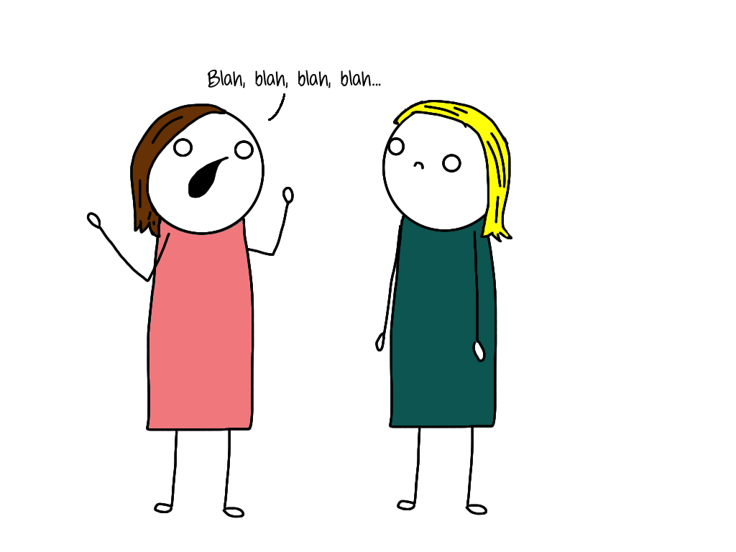
Teaching Behavior Expectations
Notes:
The purpose of this activity is to help you identify what your expectations are for the activities and routines that happen throughout the day and then develop a plan for how you will teach those expectations
Activity (10 min.): Stating Behavior Expectations: Teaching Behavioral Expectations
From the Early Childhood Learning and Knowledge Center. Download and print at https://eclkc.ohs.acf.hhs.gov/sites/default/files/pdf/no-search/iss/behavior-guidance/state-activities-videos-la-teaching-behavioral.pdf
Review each and decide which meets the needs of the participants.

Slide 30
When NOT to Teach Social Skills
Identifying teachable moments
Notes:
The best time to teach social skills is before there is a problem (i.e., blue arrow). When behavior peaks (i.e., red arrow) and children are struggling to regulate, that’s not the time to teach.
How do you know when children in your class are struggling with self-regulation?

Slide 31
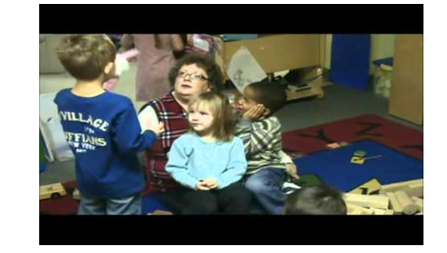
Teaching Rules in Context
Retrieved from https://www.youtube.com/watch?v=0YUXZQ9FlB8
Notes:
Note to presenter: Watch the video before sharing with participants.
We are going to watch a video which demonstrates how to teach the rules within context. What do you see the teacher doing?
Video link: Teaching rules in context https://www.youtube.com/watch?v=0YUXZQ9FlB8

Slide 32
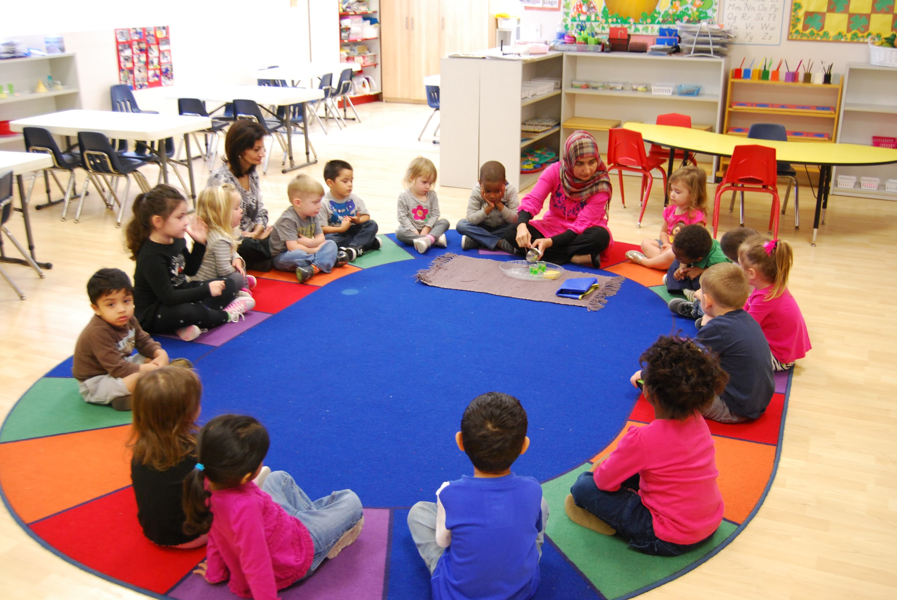
Direct Teaching
INS5. Practitioners embed instruction within and across routines, activities, and environments to provide contextually relevant learning opportunities.
(Division for Early Childhood, 2014)
Notes:
Handout: Performance Checklist Embedded Instructional Practices Checklist
We’re going to review the recommended practices on the checklist.

Slide 33
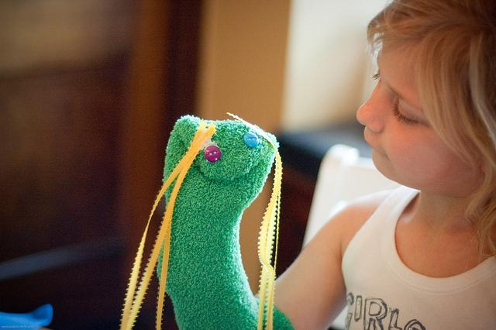
When To Teach
Plan
Practice
Play
Notes:
Target whole group and small group times to introduce new skills and provide opportunities for children to practice so they are better equipped to engage in the self-regulation process in moments that are emotionally charged.
Capitalize on other opportunities throughout the day for children to practice and get feedback (i.e., centers, meals, transitions, outside).
Remember to make it fun and engaging. Puppets, books, role playing games, etc. are ways to make it fun and interesting for children.

Slide 34
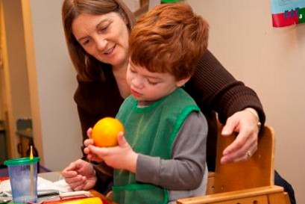
Systematic Instruction
INS6. Practitioners use systematic instructional strategies with fidelity to teach skills and to promote child engagement and learning.
(Division for Early Childhood, 2014)
Notes:
Handout: Performance Checklist for systematic Instructional Practices Checklist, (ECTA, 2018)
“Teaching strategies used to provide targeted instruction on social-emotional skills are similar to the strategies used for instruction across the curriculum but they are designed and delivered with the learning goals of particular children in mind” (Grisham-Brown, Hemmeter, Pretti-Frontczak, 2017, p. .222).

Slide 35
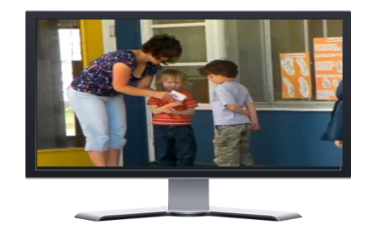
Individualized Support
Retrieved from https://www.youtube.com/watch?v=gv25iBZSw7o
Notes:
Let’s watch a video demonstrating the use of individualized support for a child.
Use checklist while watching video to look for the use of recommended practices.
Video: https://www.youtube.com/watch?v=gv25iBZSw7o

Slide 36
Exit Ticket
Share something you plan to
try
investigate
share
Notes:
Wrap it up by having participants share one of the bulleted items on the slide.

Slide 37
Resources
National Center for Pyramid Model Innovations,
www.challengingbehavior.org
IRIS Center, www.iris.peabody.vanderbilt.edu
Early Childhood Learning and Knowledge Center, eclkc.ohs.acf.hhs.gov

Slide 38
References
Andrews, T. (2016). Rules, puppets, and tools, oh my. Presentation presented at the 13th annual National Training Institute on Effective Practices: Addressing Challenging Behavior, St. Petersburg, FL.
Center on the Developing Child at Harvard University. (2012, June 18). InBrief: Executive function: Skills for life and learning [Video]. (Retrieved from https://www.youtube.com/watch?v=efCq_vHUMqs)
Copple, C., & Bredekamp, S. (2009). Developmentally appropriate practice in early childhood programs serving children from birth through age 8. Washington, DC: National Association for the Education of Young Children.
Notes:
Add ECLK

Slide 39
References, Slide 1
Division for Early Childhood. (2017). DEC recommended practices in early intervention/early childhood special education 2014. (Retrieved from http://dec-sped.org/recommendedpractices)
Grisham-Brown, J., Hemmeter, M.L., & Pretti-Frontczak, K. (2017). Blended practices for teaching young children in inclusive settings (2nd ed.). Baltimore, MD: Paul H. Brookes.
Head Start Early Childhood Learning and Knowledge Center. (2012). Stating behavioral expectations: Teaching behavior expectations. (Retrieved from eclkc.ohs.acf.hhs.gov)
Notes:
Add ECLK

Slide 40
References, Slide 2
Head Start Early Childhood Learning and Knowledge Center. (2012). Schedules and routines: Group problem solving facilitators guide. (Retrieved from eclkc.ohs.acf.hhs.gov)
McClelland, M.M., & Tominey, S.L. (2016). Stop, think, act: Integrating self-regulation in the early childhood classroom. New York, NY: Routledge.
Murray, Gallagher, & Rosanbalm. (2016). Co-regulation: An evidence-based approach to building self-regulation in early childhood. Presented at the 16th National Early Childhood Inclusion Institute, Chapel Hill, NC.

Slide 41
Thank You!
If you have any questions about the content in this module or need further assistance implementing a systems approach to early childhood inclusive practices, please contact the early childhood staff at the following T/TACs.
Regions 1 & 8 VCU 804-828-6947 or 434-292-3723
Regions 2 & 3 ODU 757-683-4333
Region 4 GMU 703-993-4496
Region 5 JMU 540-568-6746
Regions 6 & 7 VT 540-231-5167

